Slide 1
Monopoly & Monopolistic Competition
Monopolistic Competition
Management 405
Prof. Paola Giuliano · UCLA Anderson

Slide 2
Monopoly & Monopolistic Competition · Roadmap
Outline
1
Profit maximization for price searchers
Set MR = MC; markup and the Lerner index
2
Monopoly and welfare impact
How monopoly restricts output and reduces welfare
3
Government and market power
Antitrust, regulation, and market definition
4
Monopolistic competition
Free entry drives long-run profit to zero
Management 405 · Monopoly and Monopolistic Competition
2

Slide 3





Monopoly & Monopolistic Competition · Market Structures
Where We Are — and Where We're Going
WE ARE HERE
Least market power
Most market power
Perfect
Competition
Monopolistic
Competition
Oligopoly
Monopoly
(Price takers)
(Price searchers)
Management 405 · Monopoly and Monopolistic Competition
3

Slide 4
Monopoly & Monopolistic Competition · Market Structures
Market Structure: Monopolistic Competition
Number of firms | Many sellers
Product differentiation | Perceived differences, but relatively close substitutes (How to get market power: Palessi)
Entry conditions | No barriers to entry
Profit potential | Normal profit in the long run; profits or losses only in the short run
Examples | Professional services (plumbers, gardeners); restaurants; clothing
Management 405 · Monopoly and Monopolistic Competition
4

Slide 5
Monopoly & Monopolistic Competition · Monopolistic Competition
Monopolistic Competition: The Role of Entry
Monopolistic competition
  Large number of firms
  No entry barriers
Short run: economic profits are possible
Long run: entry erodes economic profits
  Long-run economic profits approach zero
Problem Set 4 · #3
Management 405 · Monopoly and Monopolistic Competition
5

Slide 6

Monopoly & Monopolistic Competition · Monopolistic Competition
Monopolistic Competition: Short Run
P
P*
Profit
MC
ATC
ATC
MR
D
Q*
Q
Management 405 · Monopoly and Monopolistic Competition
6
Notes:
Short run. Firms that differentiate are perpetually looking for those short term profits.

Slide 7
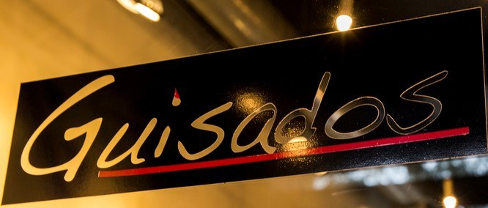


Monopoly & Monopolistic Competition · Monopolistic Competition
Monopolistic Competition: Long-Run Entry
Price
Entry shifts demand down and makes it more elastic (flatter)
LAC
P₂ = LAC
LMC
D₁
D₂
MR₂
Q₂
Output
In the long run, each monopolistically-competitive firm earns zero economic profit (P = LAC)
Management 405 · Monopoly and Monopolistic Competition
7
Notes:
Long run: Entry of new firms makes the incumbent firm’s demand more elastic (less steep) due to the availability of substitutes. Entry of new firms also shifts the incumbent firm’s demand down due to the fact that the firm is now splitting the market. Marginal revenue will shift accordingly.
As long as there are positive profits, more firms will enter. Demand will shift down to where it meets average total cost, so that profits are zero.
Note that the entry of firms does not lead to the perfectly competitive outcome. There is still a price mark up over the MC due to downward sloping demand.

Slide 8

Monopoly & Monopolistic Competition · Monopolistic Competition
The Case of Luxottica
▶ Watch: 60 Minutes — “Sticker Shock: Why Are Glasses So Expensive?”
Class discussion break
Management 405 · Monopoly and Monopolistic Competition
8
Notes:
https://www.youtube.com/watch?v=gDdq2rIqAlM&t=589s

Slide 9
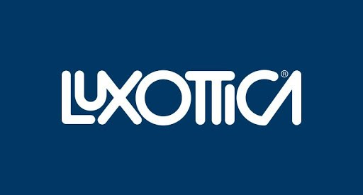
Monopoly & Monopolistic Competition · Monopolistic Competition
The Case of Luxottica
What type of market do you think the eyewear market is?
What is Luxottica's business model? How does it achieve profits?
Does Luxottica need to worry about antitrust?
Management 405 · Monopoly and Monopolistic Competition
9

Slide 10
Monopoly & Monopolistic Competition · Monopolistic Competition
Barriers to Entry
Monopolistically competitive firms make zero economic profits in the long run
A monopolist makes positive economic profits
Why the difference?
  Barriers to entry
  What are the sources of market power?
  Can we create barriers to entry?
Management 405 · Monopoly and Monopolistic Competition
10

Slide 11



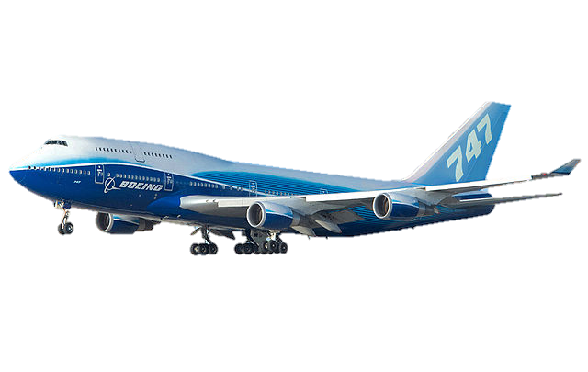
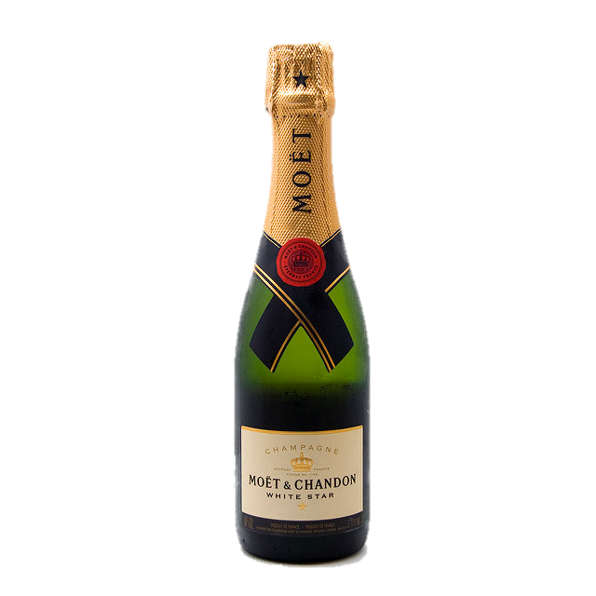
Monopoly & Monopolistic Competition · Monopolistic Competition
“Structural” Barriers to Entry
• Legal barriers
• Network effects
• Economies of scale
• Learning
• Control of resources
Management 405 · Monopoly and Monopolistic Competition
11
Notes:
Example of legal barriers include:
-- licensing requirements
-- taxi medallions
-- patents and copyrights

Slide 12



Monopoly & Monopolistic Competition · Monopolistic Competition
Switching Costs Lock Customers In
Loyalty
Compatibility
Learning
Management 405 · Monopoly and Monopolistic Competition
12

Slide 13
Monopoly & Monopolistic Competition · Monopolistic Competition
Module 5: Summary
Market power hinges on the definition of the market
Regardless of market power, set MR = MC
The real distinction:
  Price taker: MR = P
  Price searcher: MR ≠ P
Monopoly: short- and long-run profits — good for business, bad for consumers
Government interventions can curb market power
Monopolistic competition: short-run profit; long-run entry erodes it
Source of market power: barriers to entry
Management 405 · Monopoly and Monopolistic Competition
13

